Slide 1
ICSB Partnerships
Update, June 2019
Cairo, Egypt
Winslow Sargeant, Ph.D.

Slide 2
MISSION STATEMENT
The International Council for Small Business (ICSB) is devoted to the interests and advancement of small businesses globally.
HISTORY
ICSB, founded in 1955, is the oldest and largest nonprofit organization devoted to small businesses internationally.
ICSB, represented in over 85 countries, is the platform that distributes new knowledge and information on small business management and entrepreneurial development.
ICSB is the originator of the United Nations’ Resolution to create an International Name Day dedicated to Micro-, Small, and Medium-sized Enterprises on June 27 (MSMEs Day).
ICSB premier World Congress is held every June around the world and brings together leaders, experts, and entrepreneurs.

Slide 3
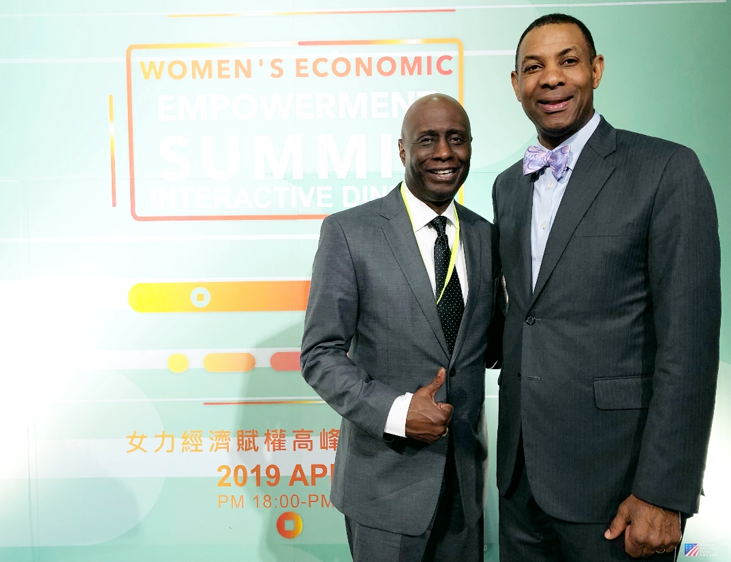
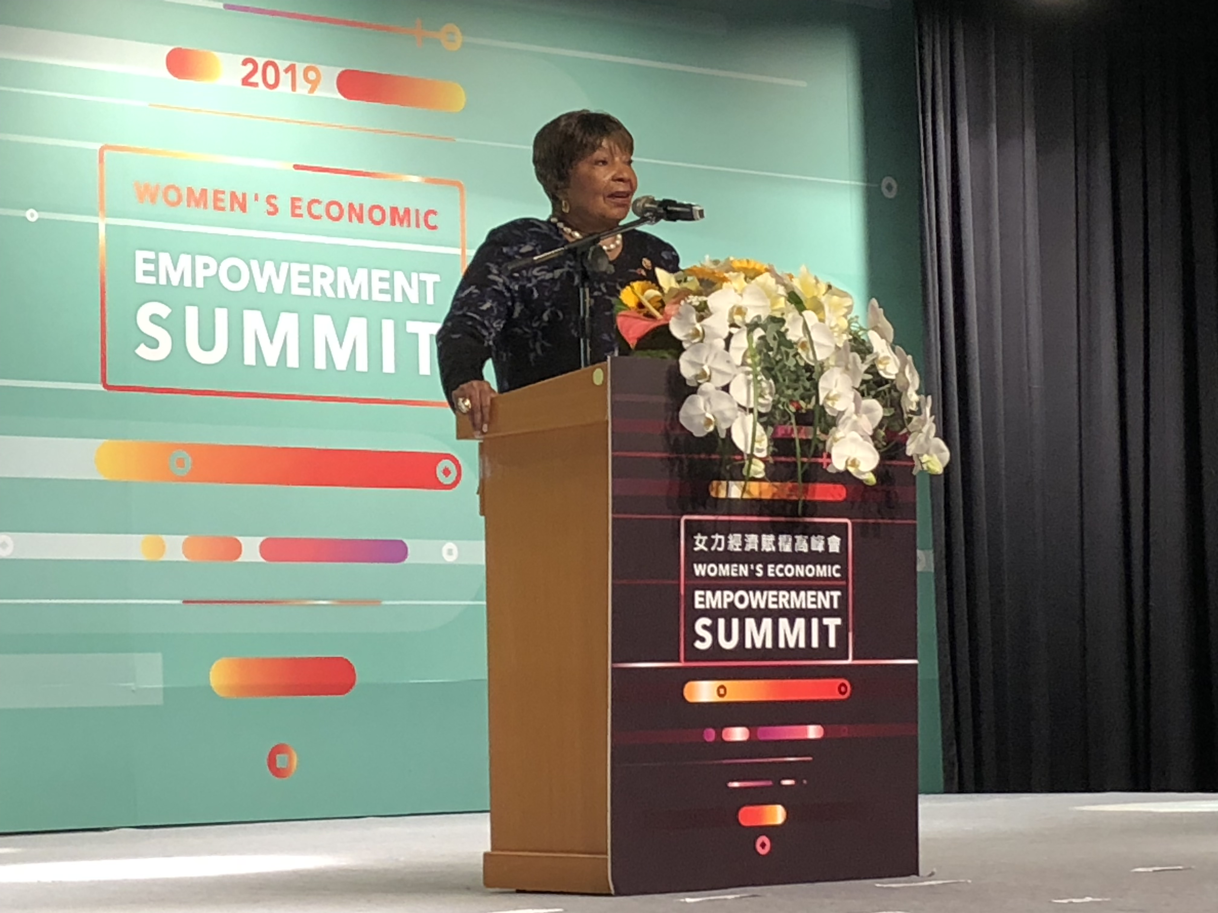
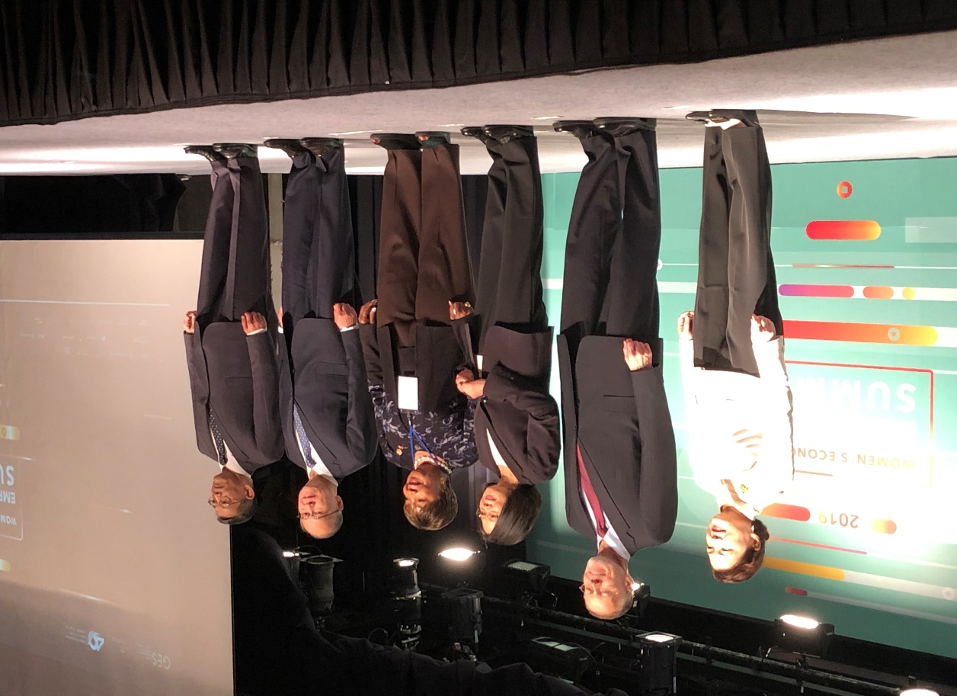
Attending and speaking
At the Women Economic
Empowerment Summit
This idea originated
with Mr. Eugene Cornelius who
Is Deputy Associate Administrator
For Trade, SBA and is on detail to
ICSB.

Slide 4
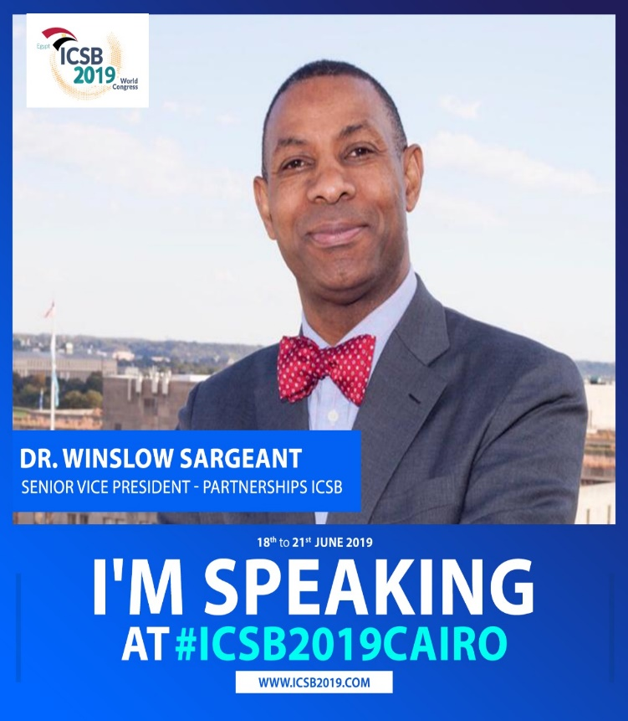
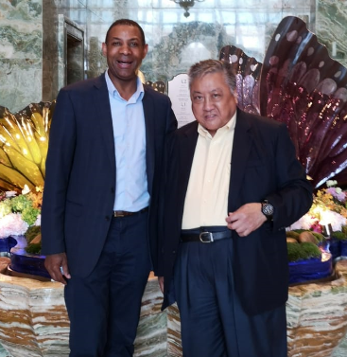
Inaugural SME World Expo, December 2019 -Macau
Speaking in Cairo, June 2019
At ICSB World Congress
With Mr. Stanley Au, Chairman of the
Small and Medium Enterprises Association of Macau, April 2019,

Slide 5
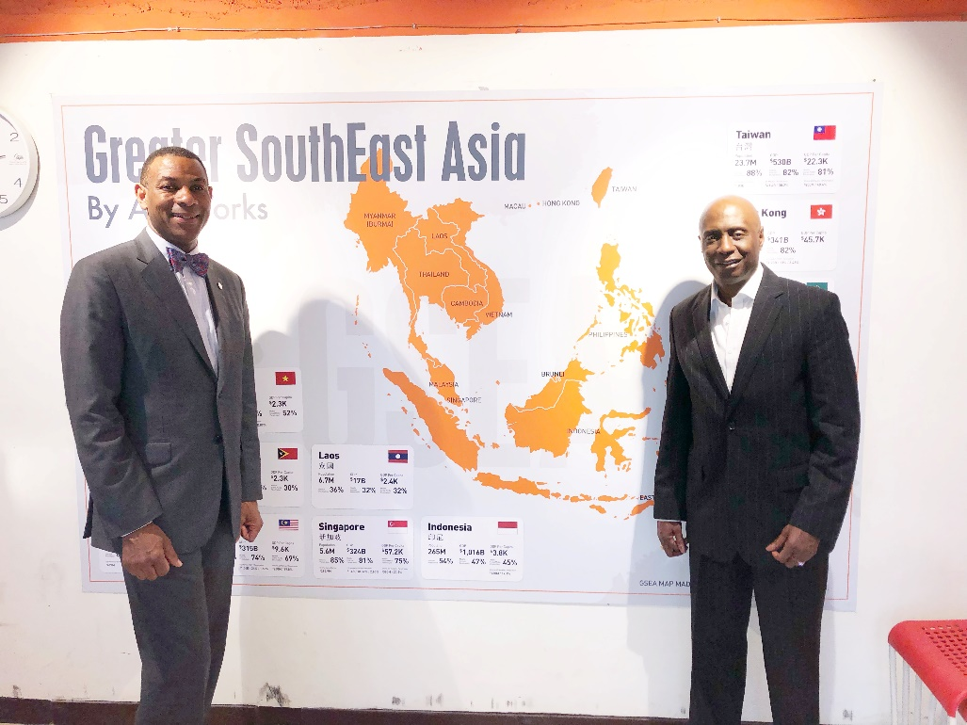
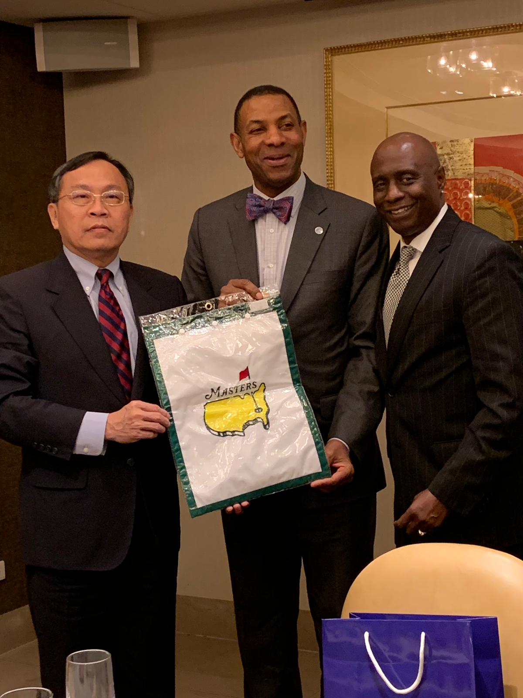
Presenting Mr. Lyu, Chairman, Bank of Taiwan
A gift from the Masters golf tournament
Eugene and I visiting the largest
Technology incubator in Southeast
Asia. This is in Taipei, Taiwan

Slide 6
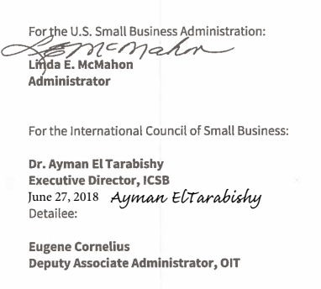
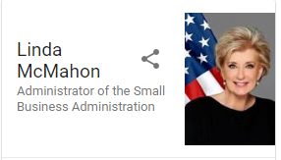
ICSB and SBA
MEMORANDUM OF UNDERSTANDING
BETWEEN
THE us Small business administration (sba) AND
International Council for Small Business (ICSB)
SBA/ICSB MOU and detail extended to December 2019.

Slide 7
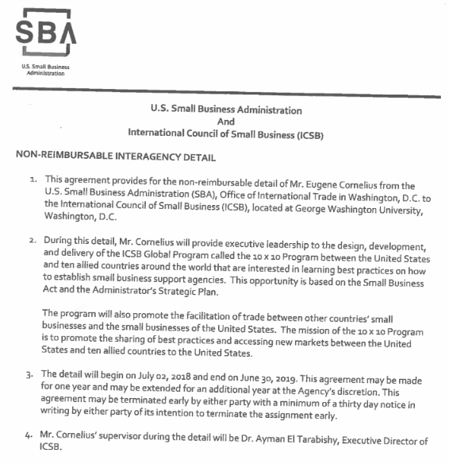
SBA will …

Slide 8
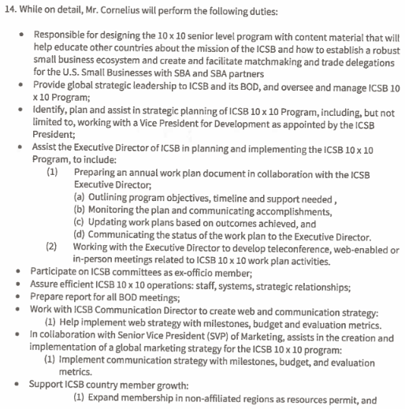
SBA 10x10 program

Slide 9
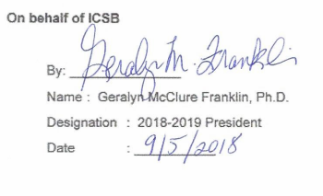
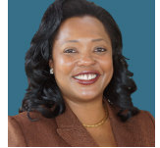
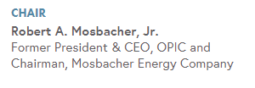
ICSB and IGD
MEMORANDUM OF UNDERSTANDING
BETWEEN
INITIATIVE FOR GLOBAL DEVELOPMENT (IGD) AND
International Council for Small Business (ICSB)
Founded in 2003 by Bill Gates Sr. and other US business leaders, the Initiative for Global Development (IGD) advises, educates and promotes the US and African private sector in order to advance Africa’s economic growth and sustainable development.

Slide 10
ICSB will …
Party B will provide support in key activities related to the Advanced Executive Program as a co-sponsor. Party B will:
Participation of ICSB executives and member organizations in the in-country programming of the IGD Advanced Executive Program, where possible.
Commit to partner with IGD and local business schools in shaping the curriculum for all Advanced Executive Programs .
Serve as a connector to The George Washington University, host of the ICSB International Office.
Provide training Certification from the International Council of Small Business and based upon our relationship with The George Washington University (GWU), seek for the certification to also be authorized through GWU.
Commit to share marketing materials with your network to highlight partnership.
Promote the Advanced Executive Program to encourage participation among ICSB clients.

Slide 11
IGD will …
Party A will take the lead in organizing all aspects of the four-day Advanced Executive Training Program. Party A will:
Serve as the lead organizer of the Advanced Executive Program on Doing Business in Africa.
Incorporate trade facilitation and opportunities to boost U.S.-Africa trade, including the African Growth and Opportunity Act (AGOA), into the overall concept of the Advanced Executive Program.
Highlight the capacity of U.S. small businesses to compete in the global marketplace.
Develop marketing materials for ICSB to share with district offices and wide network and social media platforms.
Create a webinar that gives attendees a preview into the business environment and overview of the four-day immersion program.
Engage in robust media outreach and marketing of the Advanced Executive Program.

Slide 12
Conferences

Slide 13
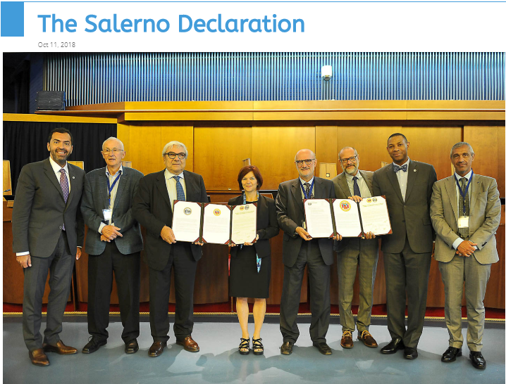
Conferences

Slide 14
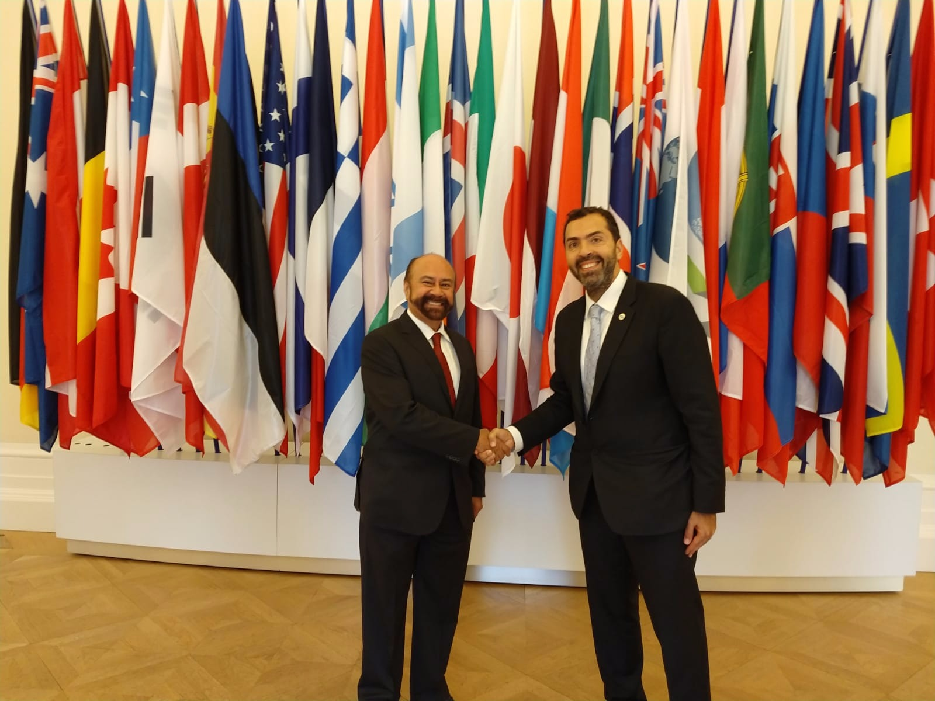
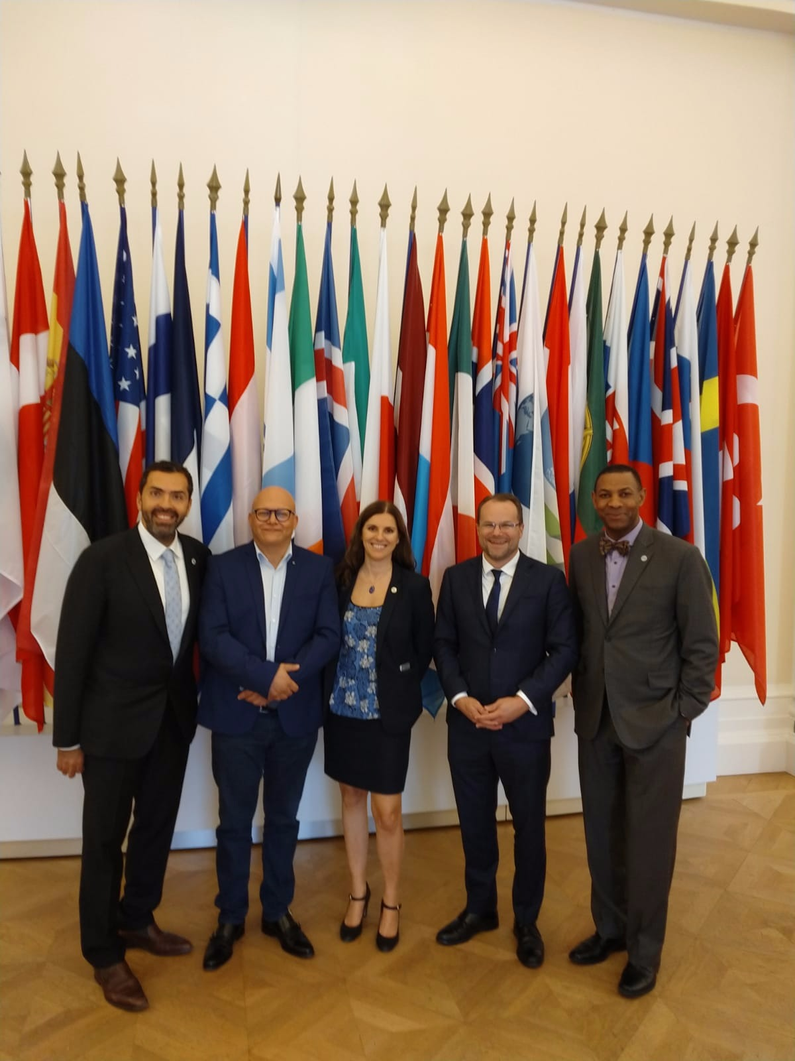
Delegates at OECD WPSME, etc
ACSB Conference in Japan
OECD Conference in Paris
Humane Entrepreneurship (Seoul)
And more

Slide 15
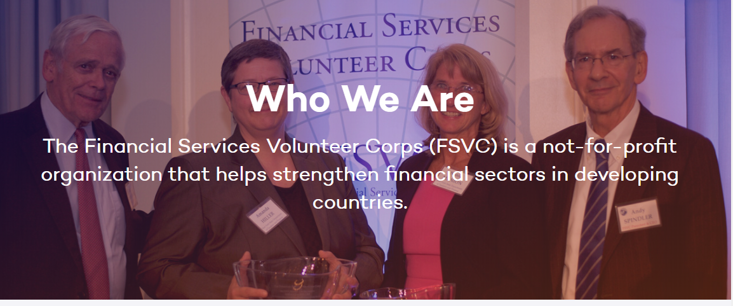
Pipeline Discussions (MOU)
Financial Services Volunteer Corps (FSVC) -- Seeking MOU with ICSB

Slide 16
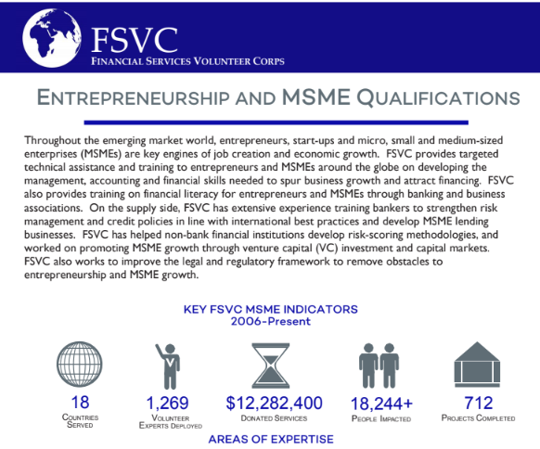
Pipeline Discussions

Slide 17
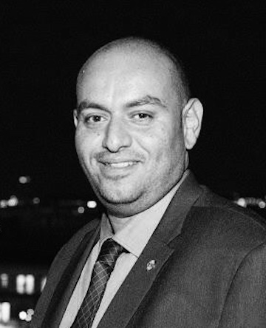
ICSB and ILO (Rome, May 2019)
News Item – ICSB commits to Decent Jobs for Youth
XX May 2019
International Council for Small Business commits to Decent Jobs for Youth, on dynamic entrepreneurship support for youth

Slide 18
ICSB is committed to working with
Government and NGOs to support
Sustainable ecosystems for
Entrepreneurs and small Business
Owners. International Trade is a
Big opportunity, especially for minority
Small Business owners.

Slide 19
ICSB Financial Partners (partial)
2017
Tatweer Misr
Facebook
WARF
University of Texas
Wilkes University
GWU
2018
Tatweer Misr
Entrepreneurs’
Organization (EO)
NFIB
GWU
Note: This list does not include contributions made to the
Annual ICSB World Congress.

Slide 20
Onward ICSB!!
The Fun begins …

