Slide 1
ICSB 2020 (January 24, 2019 Update)
Jeffrey R. Alves, Ph.D.
Past President, ICSB
Wilford White Fellow

Slide 2
2006 Vision & Strategy Committee – Key Issues
How to realize potential of ICSB’s vision
How to best achieve growth
How to provide value-added products/services
How best to improve ICSB financial capacity
How to make most of existing assets

Slide 3
Mission
The International Council for Small Business is devoted to the advancement of management development practices for potential entrepreneurs and existing small business owner/managers through education, research, and the free exchange of ideas.

Slide 4
Vision
Council members representing education, industry, financial institutions, and government provide a worldwide network of idea and experience exchange on management assistance for small business. By filling the role of an umbrella organization, as an integrator of new knowledge, the Council reinforces rather than duplicates the work of other organizations involved in small business development. For this reason we encourage the development of national and associate affiliates of the Council so we can continue to build the information exchange network in many countries.

Slide 5
Strategic Vision
Leverage the unique member and affiliate expertise

Slide 6
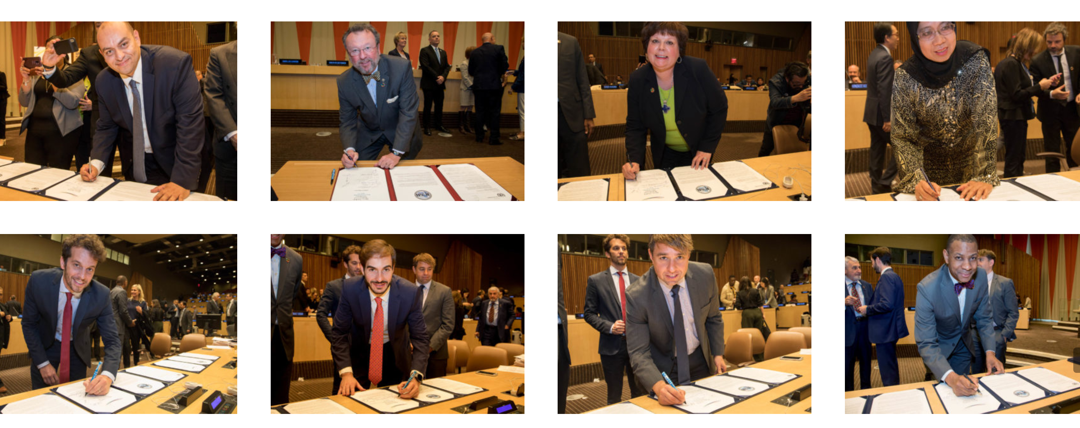
Strategic Vision
“Sit at table” with organizations and groups that influence entrepreneurship and SMEs.

Slide 7
2020 Strategic Financial Goals
Membership $100,000 (4,000 members)
Partners/Sponsors 300,000
Conferences 150,000
Other programming 100,000
$650,000
MEMBERSHIP AT 4,000 +
HAVE NOT COMPLETELY MET OTHERS
but reached the 50% Mark

Slide 8
Affiliate Development
Continue support and communication of existing affiliates: - Created websites for CCSBE and ECSB - USASBE and ECSB uses ICSB 3rd party
conference submissions system
Support Regional Affiliate Councils
ACSB is a success and MCSBE is launching soon with Kuwait, Saudi Arabia, Bahrain, and UAE
Increase affiliates to 25 from 14
2007 we had 9 affiliates and 2 chapters
2019 we have 19 affiliates and 3 chapters

Slide 9
Expand Programming
ICSB-managed conferences (
GW October
Italy (started in 2018)
France (starting in 2019)
Maccau (starting in 2019)
Clearinghouse
Started in 2018 with UAEU – in Ain, UAE
Certification program(s)
Started in 2018 with 3 cohorts so far
ICSB Academy – summer programs
Launched in 2015

Slide 10
Expand Programming (CONTD)
Certification program(s)
Social Entrepreneurship – 1st year
Innovation & Creativity – 1st year
Global Entrepreneurship – 1st year
ICSB Academy – summer programs
4th year running – generates $20K a year
Most successful was in 2016
Global Youth E’ship programming
None yet run

Slide 11
Role of IO
Can’t achieve strategic vision with all volunteer organization – IO must take stronger lead
Streamline decision-making
Board sets strategic vision, provides fiduciary oversight and governance
IO, with member support, responsible for executing strategic & annual workplans

Slide 12
IO in 2020?
CEO – Action needed – Partime Ex Dir
Director of Programs - None
Development Director - None
Communications/Affiliate & Membership Manager - None
Operations Manager - YES

Slide 13
Is It Possible?
3
300,000USD
9
90,000USD
15
37,500USD
4,000
100,000USD
10,000
Notes:
Global – 3 @ 100 ea = 300,000
NGO – 9 @ 10 ea = 90,000
Univ – 15@2,500 = 37,500

